Slide 1
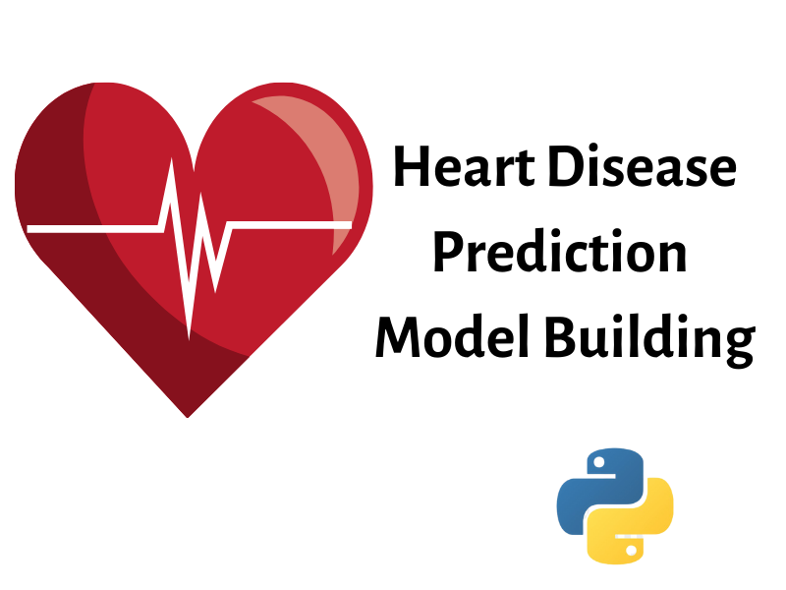
By
Sushanthik Reddy Poreddy
Guided by Prof. Chaojie Wang
Spring 2023

Slide 2

Introduction
Health occupies utmost priority in everyone’s life.
Unhealthy behaviors and eating habits.
Looks into prevention.
How many are taking actions based on their health outcomes.
There is a huge rise in the number of people being affected with heart disease day-by-day globally.
This might be due to improper food habits.

Slide 3

Data Source
The source for this data is IEEE(Institute of Electrical and Electronics Engineers)
This dataset is a combination of 5 different datasets namely Cleveland, Hungarian, Switzerland, Long Beach VA, and Statlog (Heart) Data Sets.
This dataset was submitted by “Manu Siddhartha” to IEEE and the format of this dataset is CSV.
Size of dataset is 38.76 KB.
The dataset has 1190 rows and 13 columns.

Slide 4
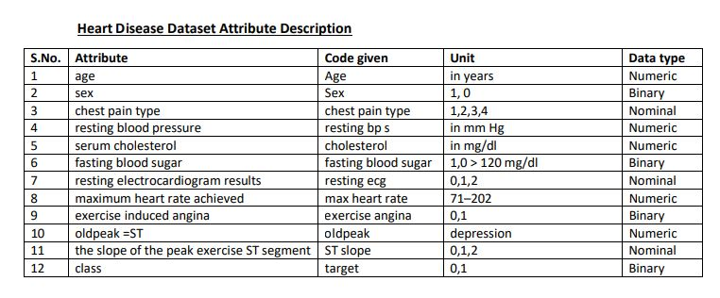
Data Set Information

Slide 5

Problem Statements
What is the impact of the heart rate on heart diseases?
Based on the dataset available, I will try to figure out which gender and which age group are more prone to heart diseases?
How accurate the Machine Learning models are being able to predict the chance of having heart diseases based on variables that I considered?

Slide 6

Steps I followed
Data Collection
Checking for Null values
Data Visualization
Splitting the data into train and test data sets
Running the Machine Learning Models
Results

Slide 7

Exploratory Data Analysis

Slide 8
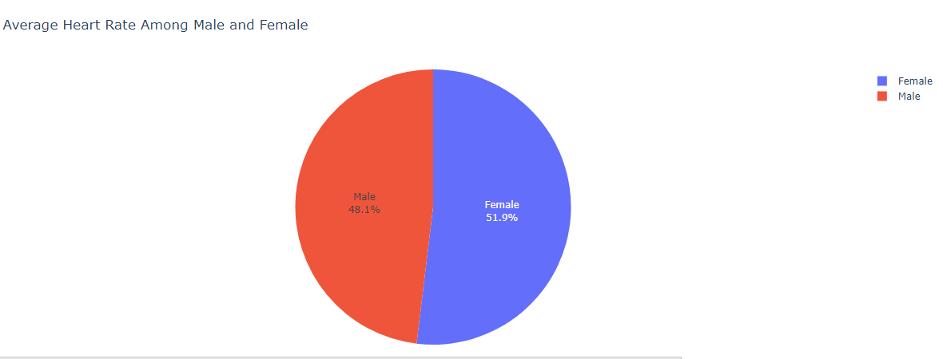
Average heart rate among both genders

Slide 9
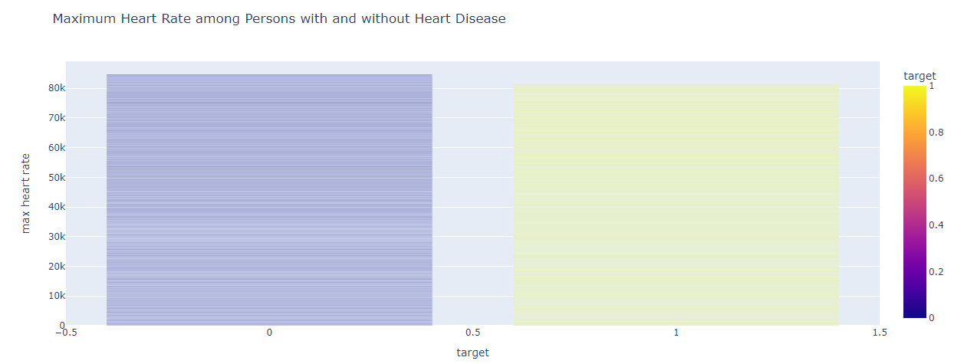

Slide 10
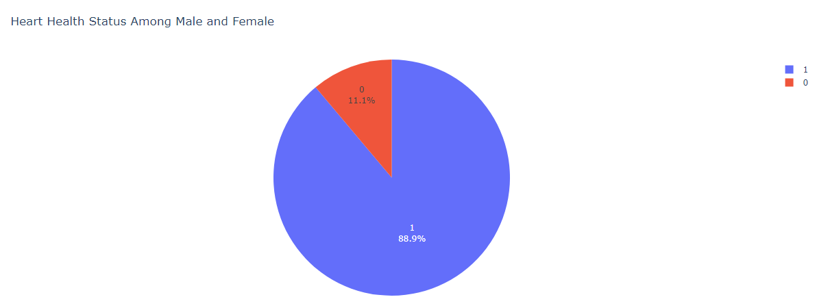

Slide 11
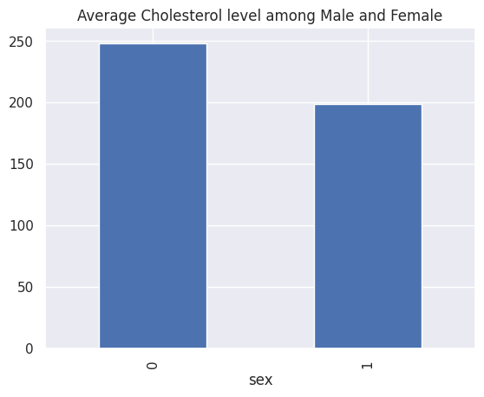
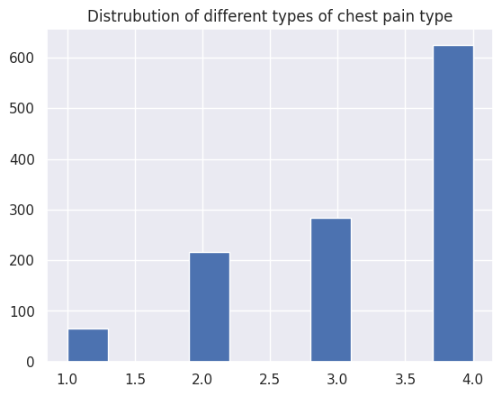

Slide 12
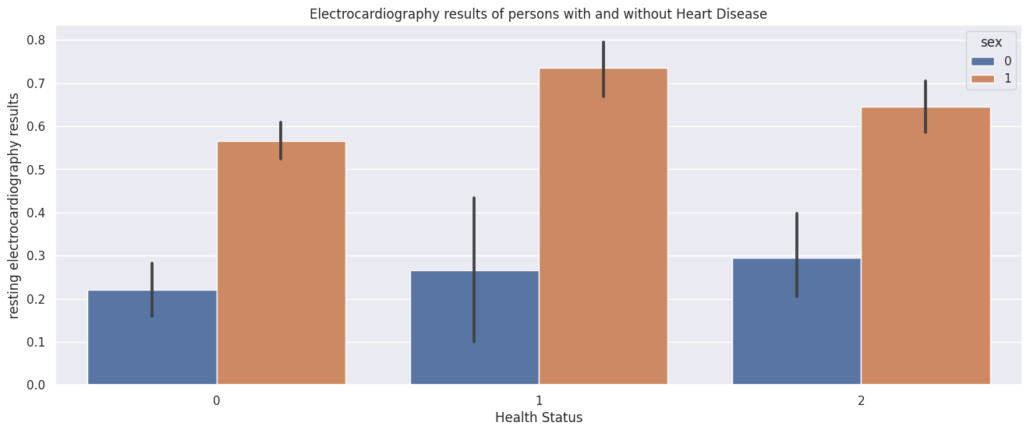
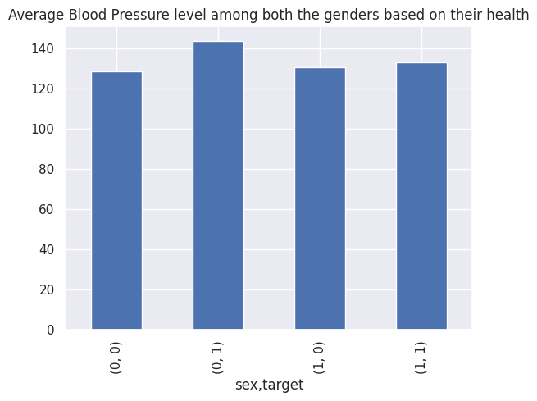

Slide 13
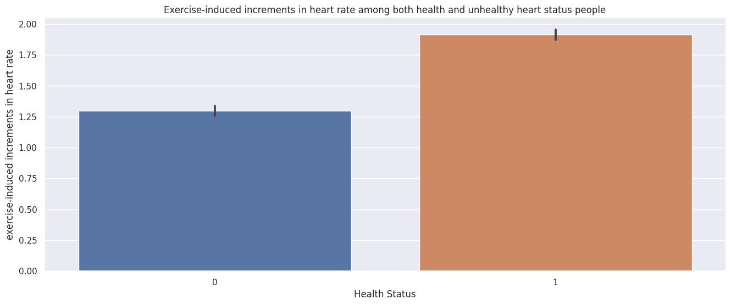
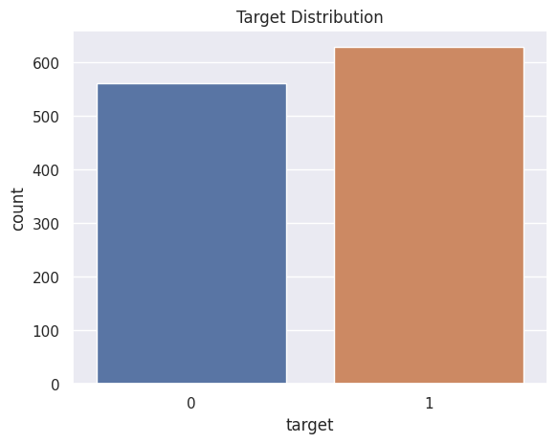

Slide 14
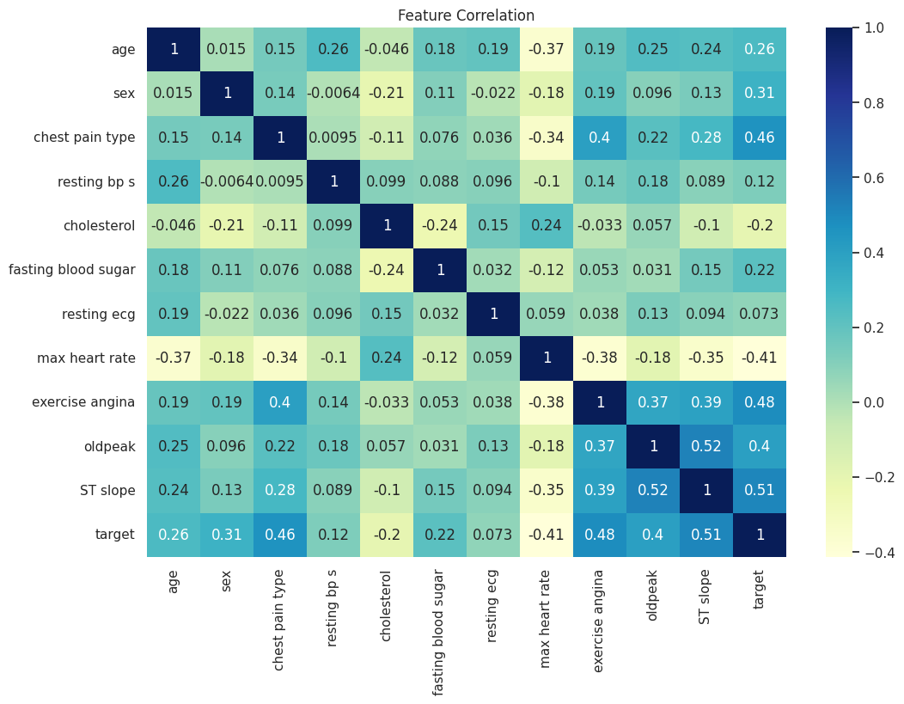
Correlation Matrix

Slide 15

Machine Learning
vgb

Slide 16

Machine Learning
Splitting the Data Set
Scaling the Data
Running the Machine Learning Models on the training dataset
Finding the best f1-score
Running the best model on the test dataset
Comparing the f1-score of train and test dataset

Slide 17
Machine Learning Models
Random Forest Classifier
Decision Tree Classifier
Naïve Bayes Classifier

Slide 18
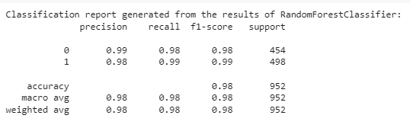
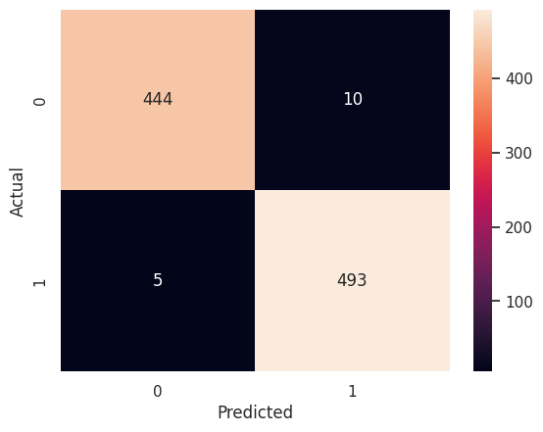
Random Forest Classifier

Slide 19
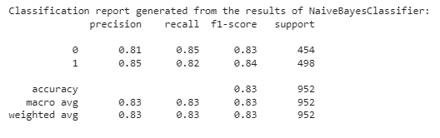
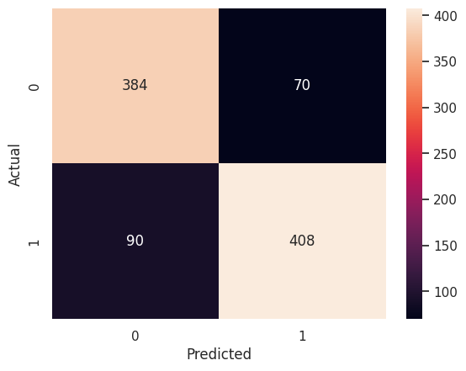
Naive Bayes Classifier

Slide 20

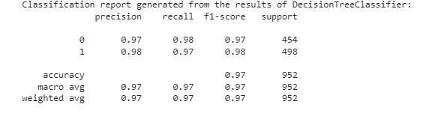
Decision Tree Classifier

Slide 21
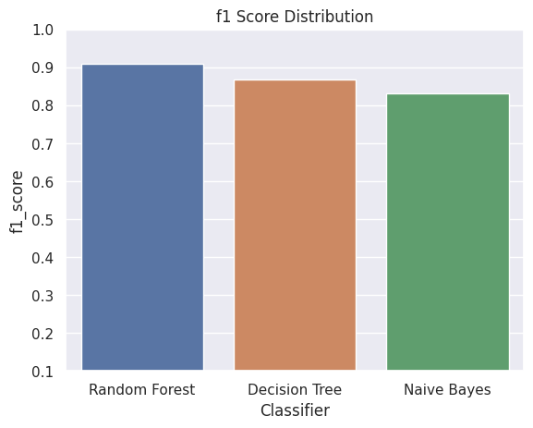
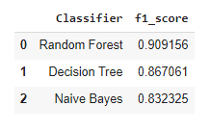
Finding the best model

Slide 22
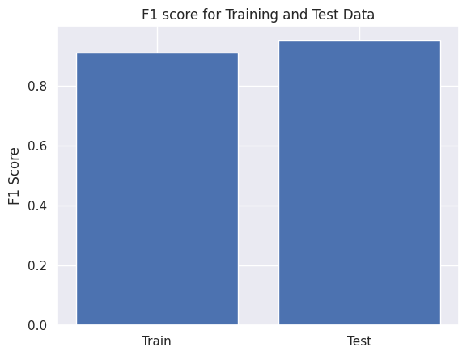
Comparing the Scores of test and train data with the best model

Slide 23
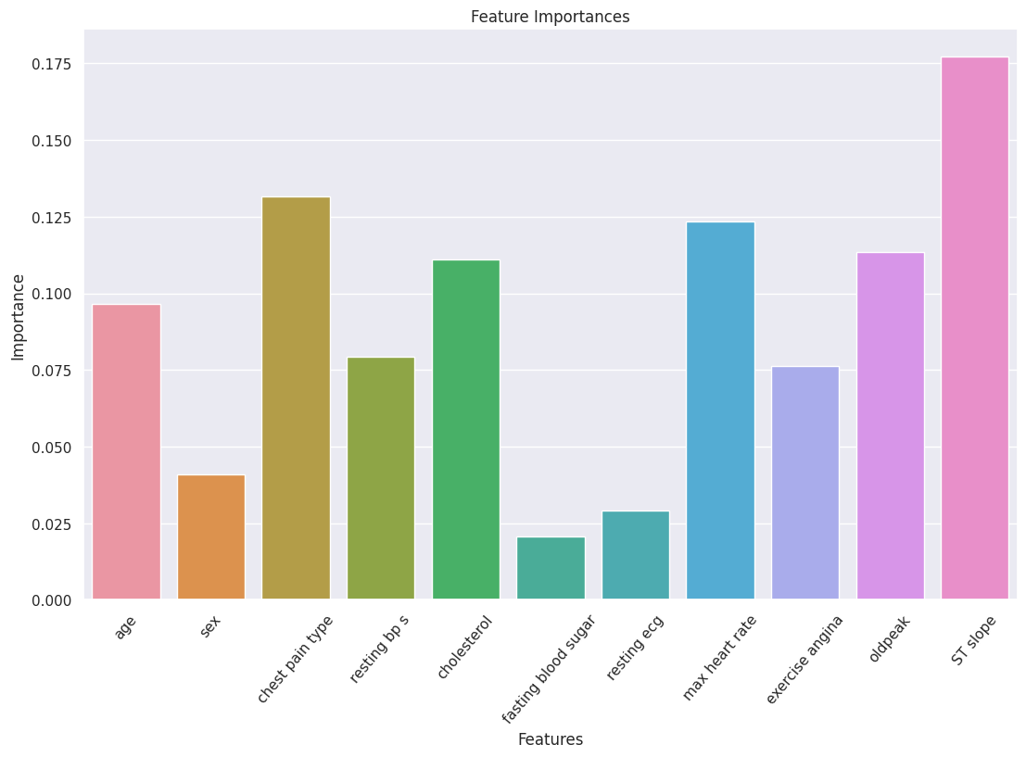
Most Important Features

Slide 24
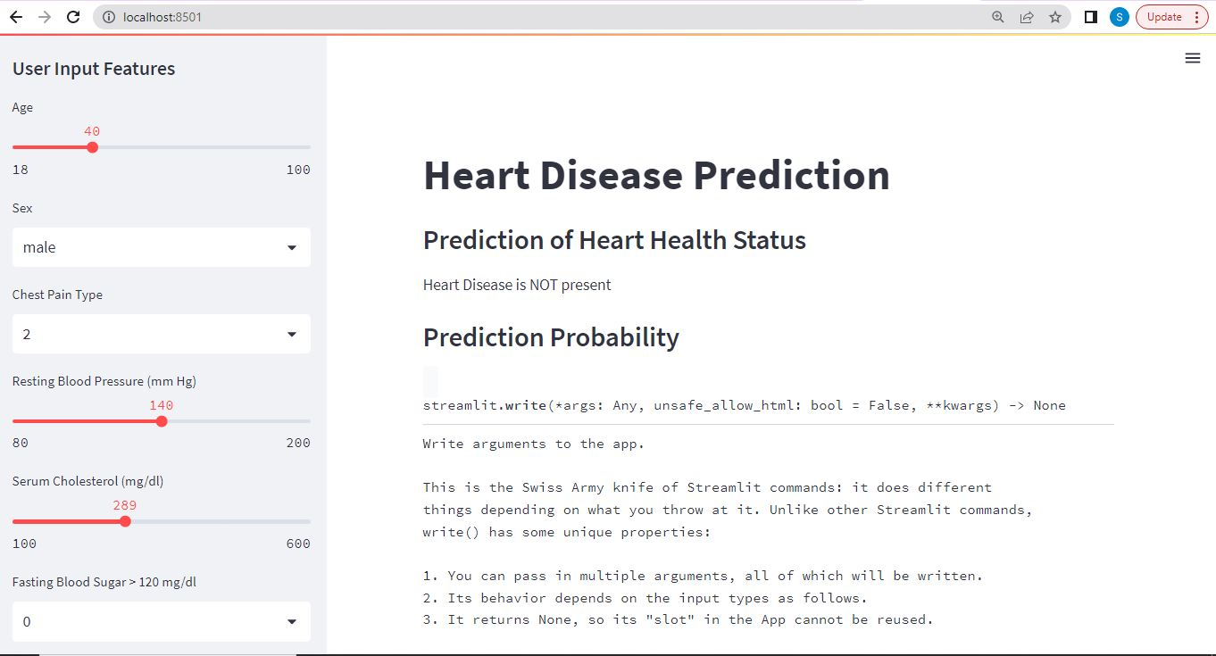
UI Screen developed using Streamlit for Predicting the target variable

Slide 25
Conclusion
Random Forest Classifier model best predicts the chance of heart diseases.
The slope of the peak exercise(ST_Slope) segment feature is figured as the most important feature in the dataset.

Slide 26

References
https://docs.streamlit.io/
https://ieee-dataport.org/open-access/heart-disease-dataset-comprehensive
https://pubmed.ncbi.nlm.nih.gov/34315030/

Slide 27


